Slide 1
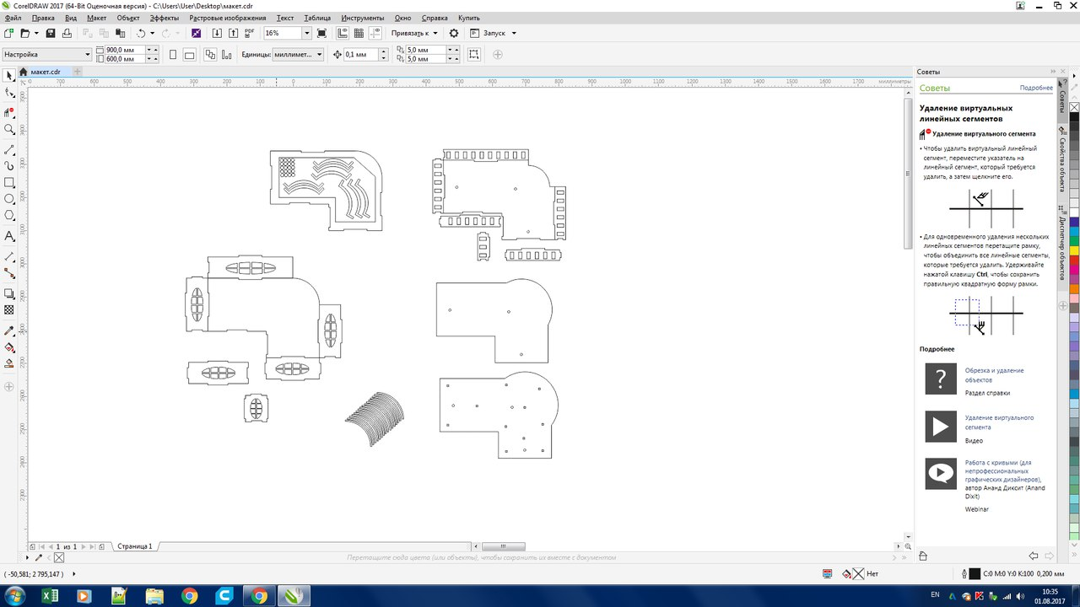
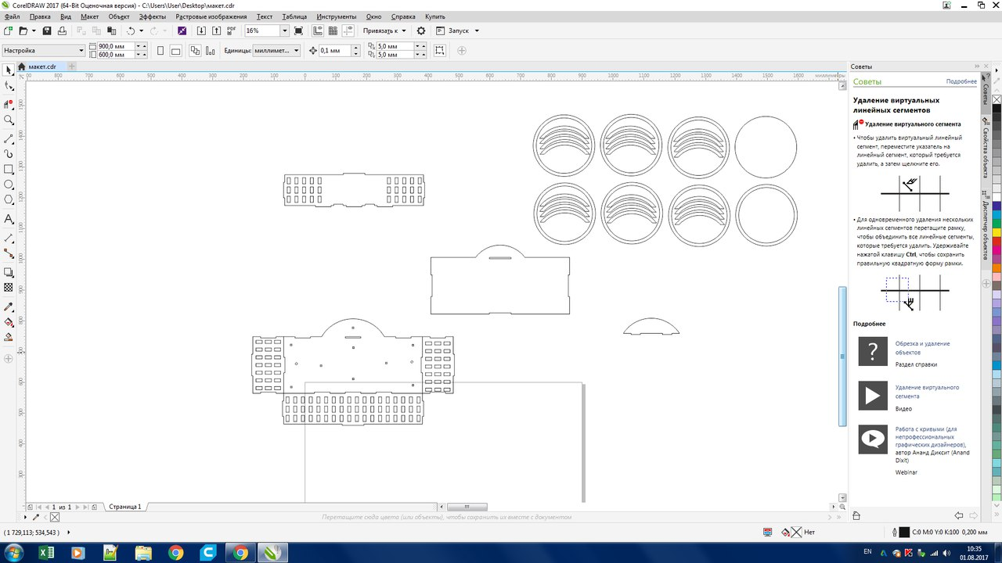
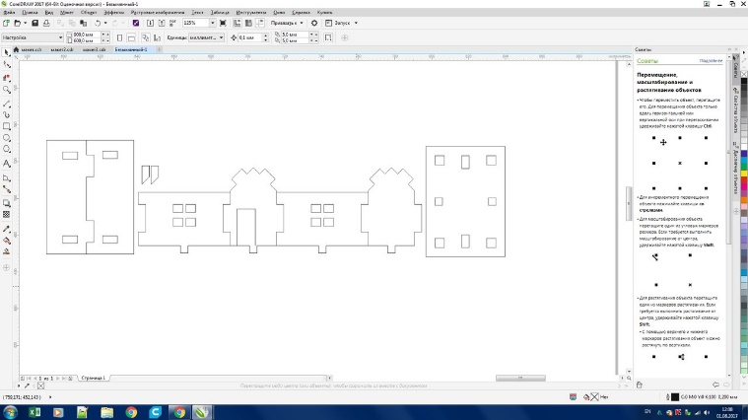
Nuclear Power Plant Replica
A smart educational model for learning basics of DIY and Python
Smirnov Vlad
Trush Nikolay
Murashov Leonid
Velovatiy Daniil
Voronkov Alexander

Slide 2
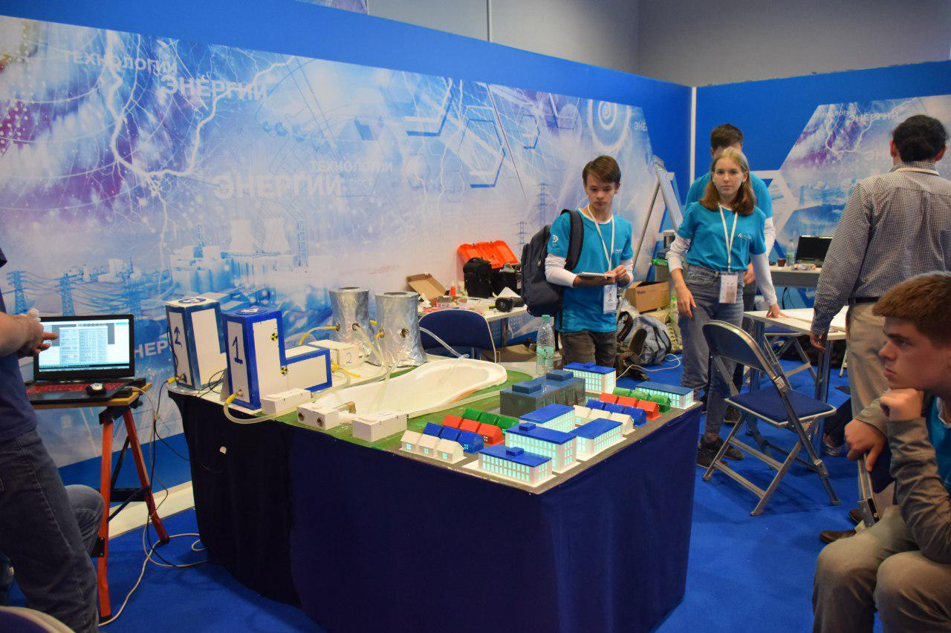
The Model
2 reactors w heaters
6 water pipes
16 temperature sensors
2 flow sensors
City w LED backlight

Slide 3
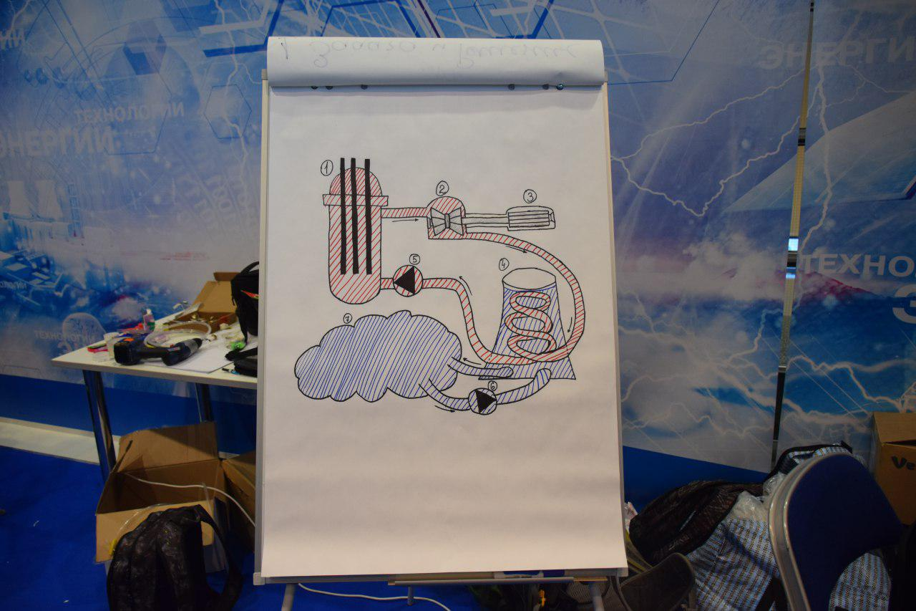
How does it work?

Slide 4
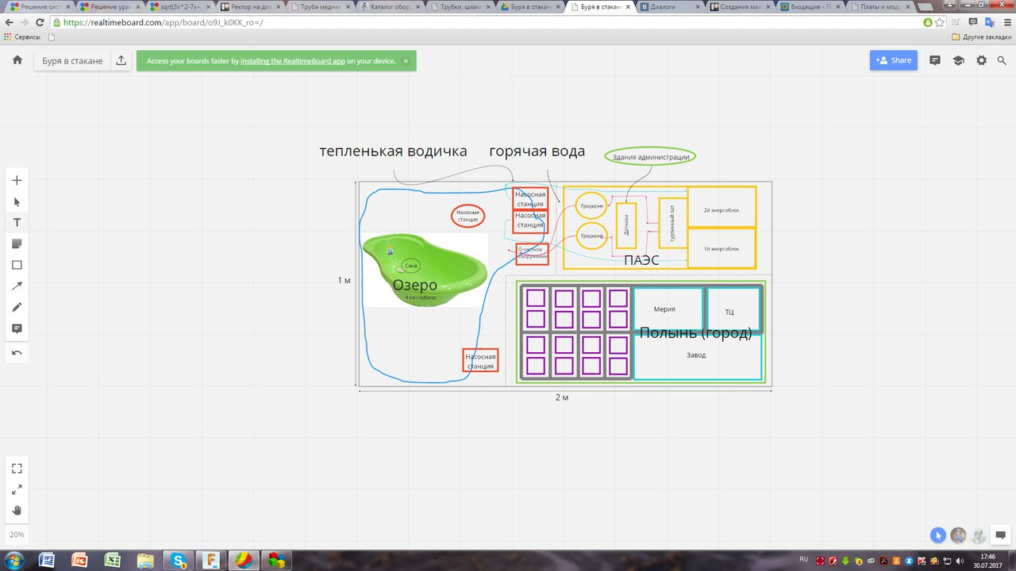
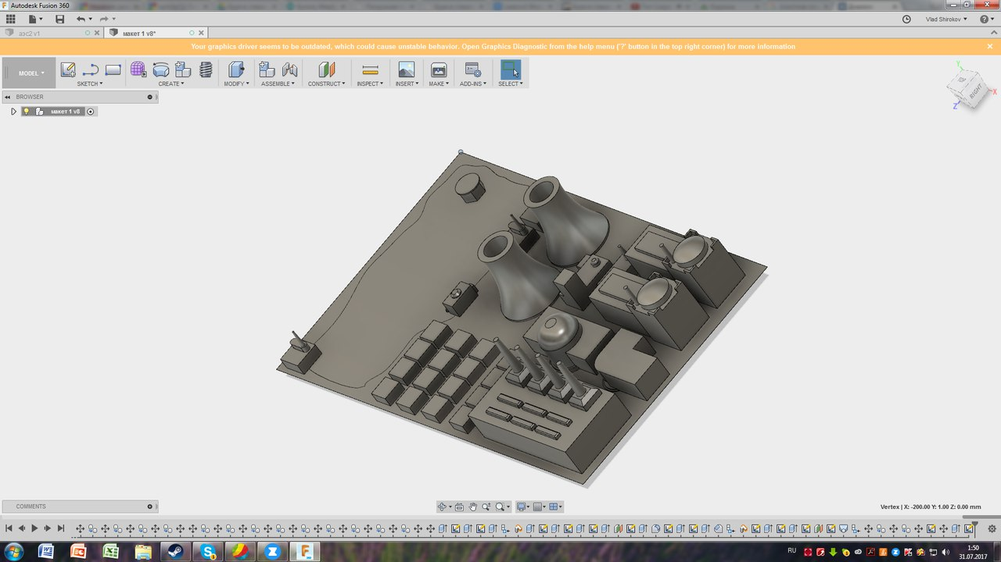
Planning & Modeling

Slide 5
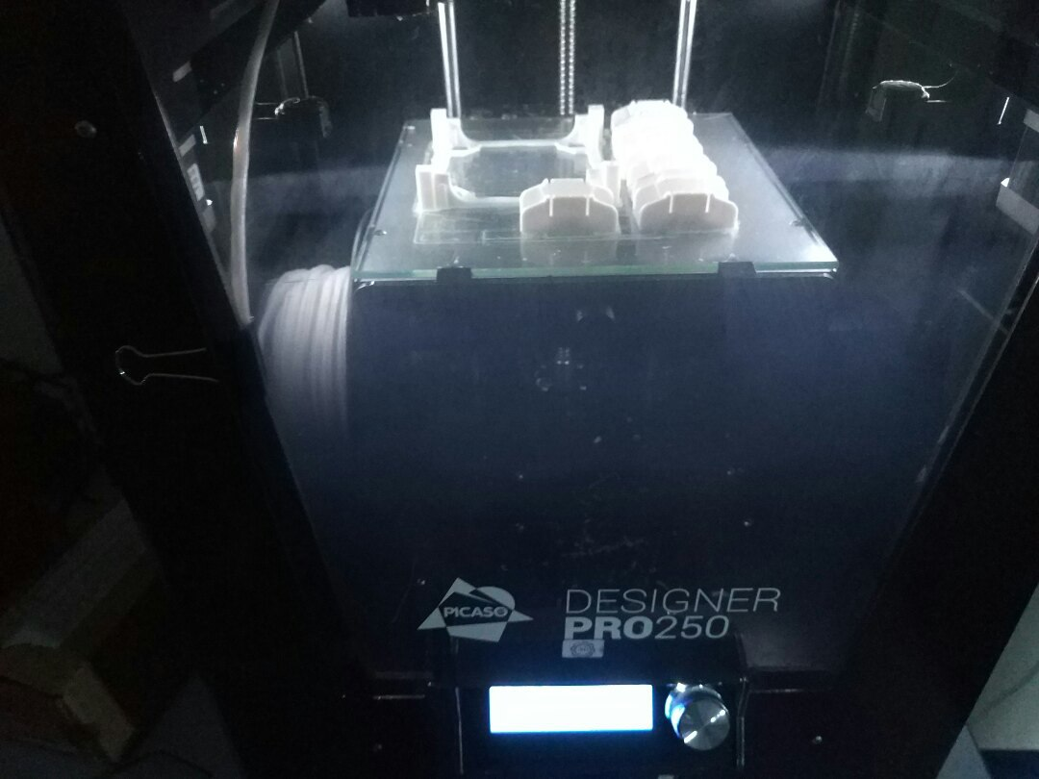
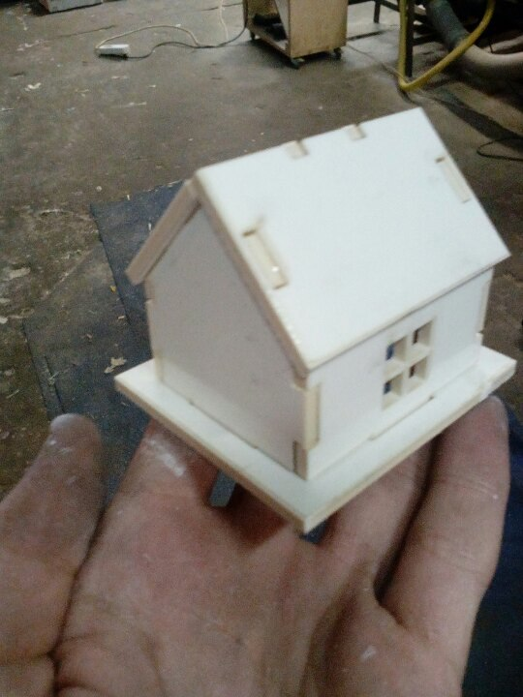
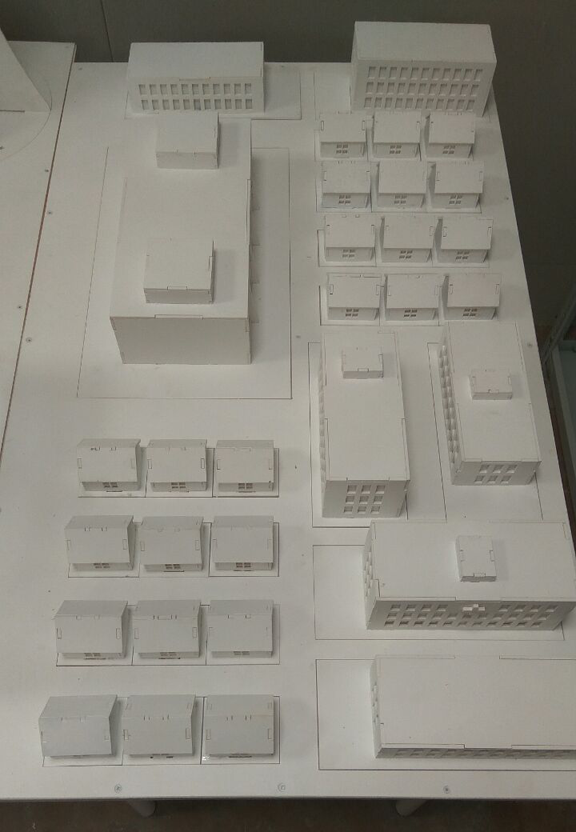
Creating Replicas

Slide 6
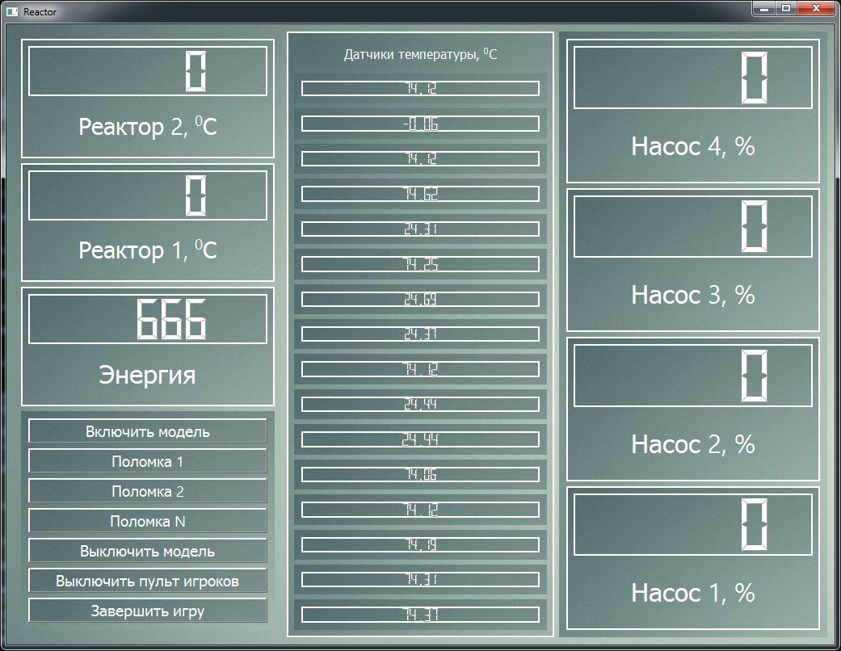
Some Pythoning
import atomic as a
plant = a.Station()
plant.connect()
pipes = []
for i in range(0, 6):
pipe = a.Pipe(plant, i)
pipe.setPower(1)
pipes.append(pipe)
print(plant.getEnergy())

Slide 7
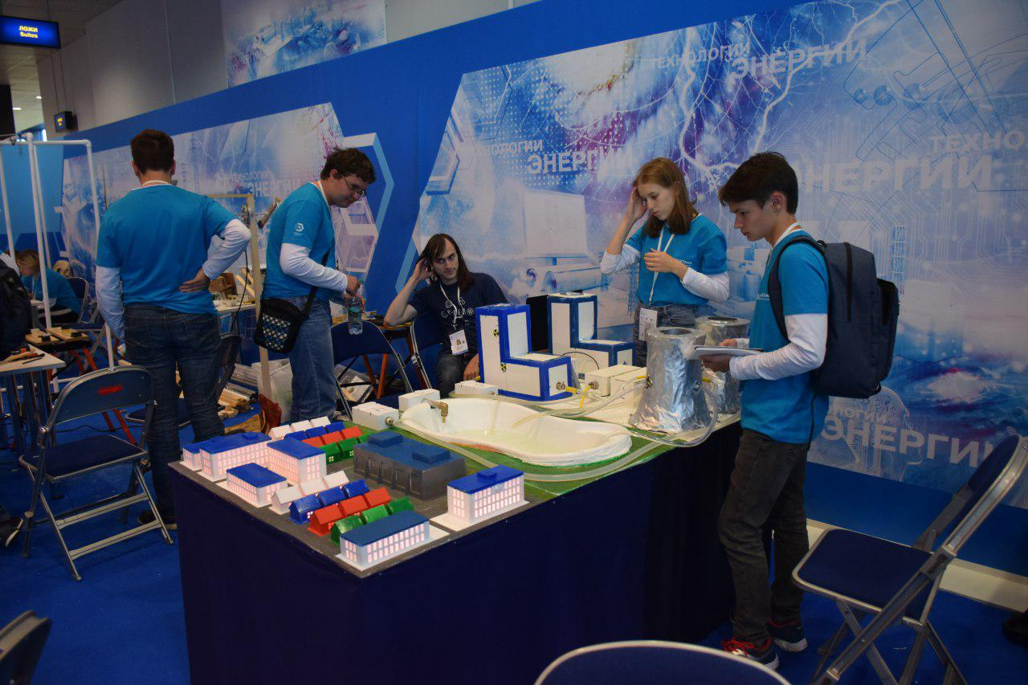
The Game

Slide 8
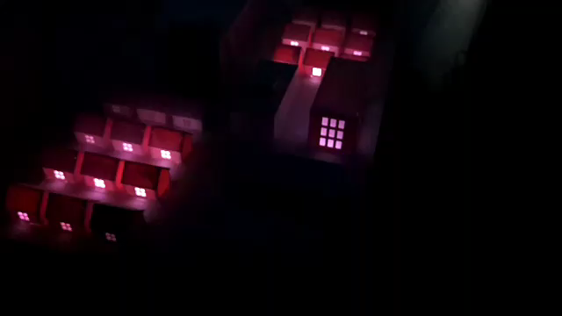
D I S C O

Slide 9
Thank you for your attention!
Спасибо за внимание!
https://github.com/LeonidMurashov/Hurricane_in_glass
Telegram: @octobus

